Slide 1
Threat Intelligence

Slide 2
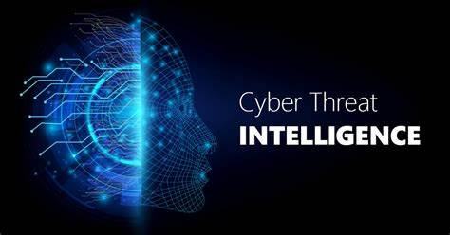
Threat intelligence
Threat intelligence is the process of collecting, analyzing, and disseminating information about potential and current cyber threats. This information is used to proactively identify and mitigate threats to an organization's network and data systems.
Threat intelligence can come from a variety of sources, such as government agencies, commercial vendors, and open-source intelligence.
The importance of threat intelligence in cyber threat analysis cannot be overstated. Organizations can proactively identify and mitigate risks before they can be exploited.
This includes understanding the tactics, techniques, and procedures (TTPs) used by threat actors, their motivations, and the potential impact of their attacks.
Threat intelligence is used by security professionals to inform risk assessments, threat modeling, and incident response plans.
It is also used to identify vulnerabilities in an organization's security posture and to prioritize security investments. By understanding the threat landscape, security teams can allocate resources more effectively and respond more quickly to emerging threats.

Slide 3
Techniques for collecting and analyzing threat intelligence
Open-Source Intelligence (OSINT): This involves gathering information from publicly available sources such as news reports, social media, and blogs. OSINT can provide valuable information on threat actors, their tactics and techniques, and the overall threat landscape.
Closed-Source Intelligence (CSINT): This involves gathering information from closed sources such as paid threat intelligence feeds, dark web forums, and other private sources. CSINT can provide more in-depth and targeted information on specific threats and actors.
Human Intelligence (HUMINT): This involves gathering information from human sources such as industry experts, law enforcement, and other security professionals. HUMINT can provide valuable insights into emerging threats and tactics.
Technical Intelligence (TECHINT): This involves gathering information from technical sources such as network logs, system logs, and malware analysis. TECHINT can provide insight into specific attacks and the tools and techniques used by threat actors.
Threat Hunting: This involves actively searching for threats within an organization's network using a combination of manual and automated techniques. Threat hunting can help identify threats that may have evaded detection by other security controls

Slide 4
Importance of threat Intelligence
sheds light on the unknown, enabling security teams to make better decisions
empowers cyber security stakeholders by revealing adversarial motives and their tactics, techniques, and procedures (TTPs)
helps security professionals better understand the threat actor’s decision-making process
empowers business stakeholders, such as executive boards, CISOs, CIOs and CTOs; to invest wisely, mitigate risk, become more efficient and make faster decisions

Slide 5
Types of Threat Intelligence
Tactical threat intelligence is used by the security operations center (SOC) to detect and respond to cyberattacks in progress. It focuses typically on common IoCs
e.g., IP addresses associated with command and control servers, file hashes related to known malware and ransomware attacks, or email subject lines associated with phishing attacks.
Operational threat intelligence helps organizations anticipate and prevent future attacks. It is sometimes called ‘technical threat intelligence’ because it details the TTPs and behaviors of known threat actors
e.g., the attack vectors they use, the vulnerabilities they exploit, and the assets they target. CISOs, CIOs, and other information security decision-makers use operational threat intelligence to identify threat actors who are likely to attack their organizations, and respond with security controls and other actions aimed specifically at thwart their attacks.
Strategic threat intelligence gives decision-makers outside of IT, such as CEOs and other executives, an understanding of the cyber threats their organizations face. It usually focuses on issues such as geopolitical situations, cyber threat trends in a particular industry, or how or why certain of the organization’s strategic assets may be targeted.
e.g, Stakeholders use strategic threat intelligence to align broader organizational risk management strategies and investments with the cyber threat landscape.

Slide 6
Tactical Threat Intelligence
Challenge: Organizations often only focus on singular threats
Objective: Obtain a broader perspective of threats in order to combat the underlying problem
Tactical intelligence is focused on the immediate future, is technical in nature, and identifies simple indicators of compromise (IOCs). IOCs are things such as bad IP addresses, URLs, file hashes and known malicious domain names. It can be machine-readable, which means that security products can ingest it through feeds or API integration.
Tactical intelligence is the easiest type of intelligence to generate and is almost always automated. As a result, it can be found via open source and free data feeds, but it usually has a very short lifespan because IOCs such as malicious IPs or domain names can become obsolete in days or even hours.
It’s important to note that simply subscribing to intel feeds can result in plenty of data, but offers little means to digest and strategically analyze the threats relevant to you. Also, false positives can occur when the source is not timely or of high fidelity.

Slide 7
Operational Threat Intelligence
Challenge: Threat actors favor techniques that are effective, opportunistic, and low-risk
Objective: Engage in campaign tracking and actor profiling to gain a better understanding of the adversaries behind the attacks
In the same way that poker players study each other’s quirks so they can predict their opponents’ next move, cybersecurity professionals study their adversaries.
Behind every attack is a “who,” “why,” and “how.” The “who” is called attribution. The “why” is called motivation or intent. The “how” is made up of the TTPs the threat actor employs. Together, these factors provide context, and context provides insight into how adversaries plan, conduct, and sustain campaigns and major operations. This insight is operational intelligence.
Machines alone cannot create operational threat intelligence. Human analysis is needed to convert data into a format that is readily usable by customers. While operational intelligence requires more resources than tactical intelligence, it has a longer useful life because adversaries can’t change their TTPs as easily as they can change their tools, such as a specific type of malware or infrastructure.

Slide 8
Strategic Threat Intelligence
Challenge: Poor business and organizational decisions are made when the adversary is misunderstood
Objective: Threat intelligence should inform business decisions and the processes behind them
Adversaries don’t operate in a vacuum — in fact, there are almost always higher level factors that surround the execution of cyber attacks. For example, nation-state attacks are typically linked to geopolitical conditions, and geopolitical conditions are linked to risk. Furthermore, with the adoption of financially motivated Big Game Hunting, cyber-crime groups are constantly evolving their techniques and should not be ignored.

Slide 9
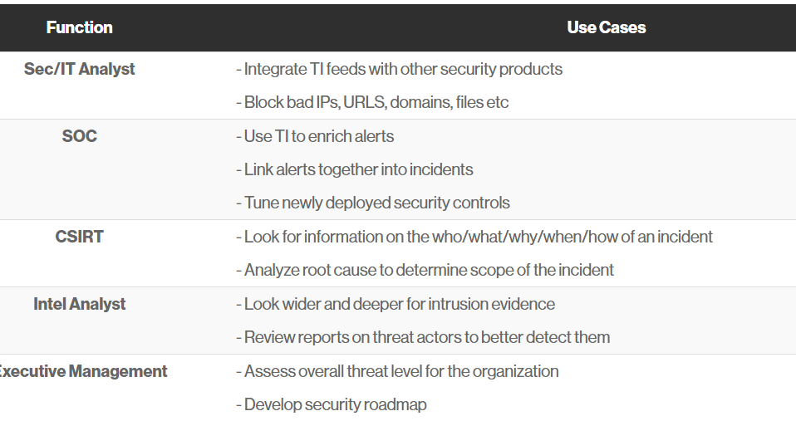
Use Case of threat intelligence

Slide 10
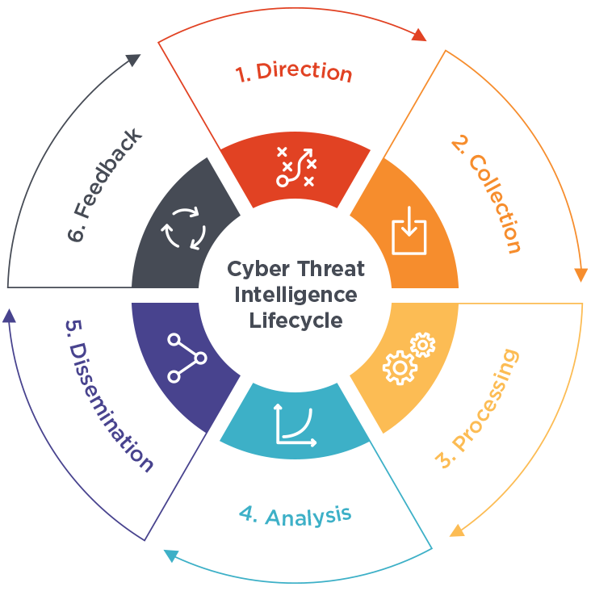
Threat Intelligence Lifecycle
Planning and direction: In this stage, the goals of the threat intelligence program are defined, and the sources and methods for collecting threat intelligence are determined. This stage involves setting up policies and procedures, identifying stakeholders, and defining the scope of the program.
Collection: In this stage, threat intelligence is collected from a variety of sources, including open-source intelligence, closed-source intelligence, technical intelligence, and human intelligence. This stage involves aggregating and filtering data from a wide range of sources, and prioritizing information based on relevance to the organization's security posture.
Processing and analysis: In this stage, the collected threat intelligence is analyzed to identify patterns and trends, and to understand the tactics, techniques, and procedures (TTPs) of threat actors. This stage involves identifying potential threats and vulnerabilities, and developing indicators of compromise (IOCs) that can be used to detect and respond to attacks.
Dissemination: In this stage, the threat intelligence is communicated to stakeholders within the organization, including security teams, executives, and other relevant personnel. This stage involves creating reports and dashboards that summarize key findings, and communicating actionable intelligence to stakeholders.
Feedback and refinement: In this final stage, the threat intelligence program is evaluated, and adjustments are made to improve the effectiveness of the program. This stage involves analyzing the impact of the threat intelligence program on the organization's security posture, and making improvements to the program based on feedback from stakeholders.

Slide 11
Tools and Resources for Threat Intelligence
Security Information and Event Management (SIEM) tools: SIEM tools are used for collecting and analyzing security-related data from multiple sources, including network devices, servers, and security devices. SIEM tools can be used to detect and respond to security threats, as well as to analyze security data for threat intelligence purposes.
Threat Intelligence Platforms (TIPs): TIPs are used for aggregating and managing threat intelligence data from multiple sources. TIPs can help automate the collection and analysis of threat intelligence, as well as provide a centralized platform for sharing threat intelligence with other security teams.
Dark web monitoring tools: Dark web monitoring tools are used for monitoring the dark web for threats and potential data breaches. Examples of dark web monitoring tools include SpyCloud and DarkOwl Vision.
Threat intelligence feeds: Threat intelligence feeds are subscription-based services that provide regular updates on emerging threats and vulnerabilities. These feeds can be customized to provide information on specific threats and industries.
Malware analysis tools: Malware analysis tools are used for analyzing malware samples to identify the tactics and techniques used by threat actors. Examples of malware analysis tools include VirusTotal, Yara, and Cuckoo Sandbox.
Human intelligence sources: Human intelligence sources, such as security researchers, law enforcement, and other security professionals, can provide valuable insights into emerging threats and trends.

Slide 12
Application of Threat Intelligence
Threat intelligence sharing: Threat intelligence sharing involves the exchange of threat intelligence between organizations and among industry peers. Sharing threat intelligence can help organizations stay ahead of emerging threats, but it also requires careful consideration of privacy and security concerns.
Threat hunting: Threat hunting is a proactive approach to identifying and addressing potential threats before they become active attacks. This involves actively seeking out indicators of compromise and other signs of potential threats, and using this information to improve an organization's security posture.
Machine learning and artificial intelligence in threat intelligence: Machine learning and artificial intelligence (AI) are increasingly being used in threat intelligence to automate data collection, analysis, and response. This can help organizations identify threats more quickly and accurately, and respond to threats more effectively.
Cyber threat intelligence for small and medium-sized enterprises (SMEs): SMEs face many of the same threats as larger organizations, but often have fewer resources to invest in threat intelligence. As a result, there is a growing need for threat intelligence solutions that are tailored to the needs and budgets of SMEs.
Threat intelligence and regulatory compliance: Regulatory frameworks such as the General Data Protection Regulation (GDPR) and the Payment Card Industry Data Security Standard (PCI DSS) require organizations to have effective threat intelligence programs in place. This means that organizations must understand heir threat landscape and be prepared to respond to emerging threats in a timely and effective manner.

Slide 13
Cont..
Malware Detection- From ransomware to spyware to viruses, it’s hard to keep track of the countless forms of malware emerging every day around the world. As part of their evidence-based data collection process, TI applications typically conduct thorough domain malware checks and retrieve actionable information from major anti-malware databases — e.g., detailing the nature of such attacks and their evolution and sharing best practices around how to detect and tackle them.
Phishing Prevention-Gone are the days when all phishing threats could be spotted with the naked eye. Today’s social engineering attacks such as spear phishing and website forgery are highly sophisticated and convincing. TI can support security professionals and other employees with the detection of advanced scams by collecting data from reliable public sources — like whois data
Vulnerability Investigation-The likelihood of successful cyber attacks remains high no matter how much organizations invest in protecting their infrastructure and data. Understanding the cause of a breach, however, can be challenging, especially when working with multiple internal systems and third-party applications.
Cyber Defense Optimization-Even when no data breach has occurred, various organizational changes require security professionals to reconsider whether their company’s cyber defenses are still optimized — e.g., mergers, acquisitions, spin-offs, joint ventures and partnerships, outsourcing of business processes, and software and hardware upgrades.
Security Awareness-Not all cyber attacks can be prevented through technology, however. It’s not rare for threats to go undetected by antivirus, firewalls, and other applications — meaning that regular employees often end up as the last line of defense against hackers and scammers.

